Slide 1
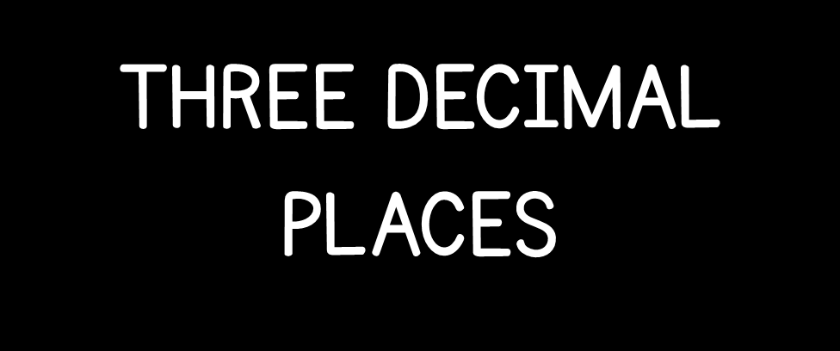

Slide 3
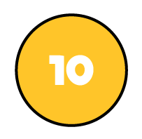

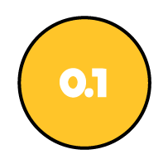
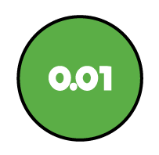

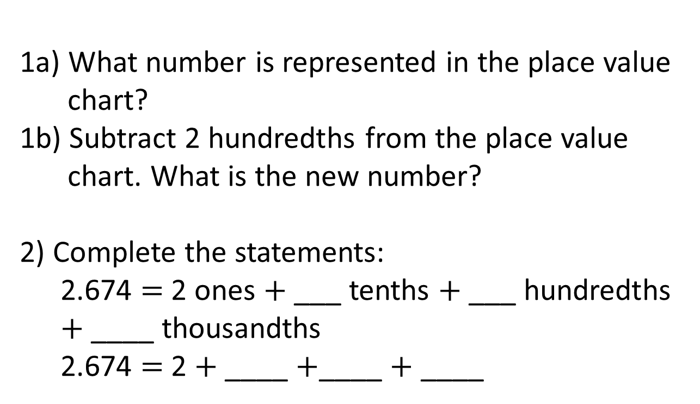
T | O | tth | hth | thth
1a) What number is represented in the place value chart?
1b) Subtract 2 hundredths from the place value chart. What is the new number?
2) Complete the statements:
2.674 $=$ 2 ones $+$ ___ tenths $+$ ___ hundredths $+$ ____ thousandths
2.674 $=$ 2 $+$ ____ $+$____ $+$ ____

Slide 4
T | O | tth | hth | thth
1a) What number is represented in the place value chart?
1b) Subtract 2 hundredths from the place value chart. What is the new number?
2) Complete the statements:
2.674 $=$ 2 ones $+$ ___ tenths $+$ ___ hundredths $+$ ____ thousandths
2.674 $=$ 2 $+$ ____ $+$____ $+$ ____
12.421
12.401
6
7
4
0.6
0.07
0.004

Slide 6
T | O | tth | hth | thth
Use place value counters to make the number:
23.004
2
There are ____ tens.
There are ____ ones.
There are ____ tenths.
There are ____ hundredths.
There are ____ thousandths.
3
0
0
4

Slide 7




Write the value of the digit 4 in each number.
1.04
43.027
0.274
My number has zero tenths.
Alex
My number has seven hundredths.
Whitney
My number has seven thousandths.
Dexter
Match each number to the correct child.
Have a think

Slide 8
T | O | tth | hth | thth
Write the value of the digit 4 in each number.
1.04
43.027
0.274
4 hundredths
4 thousandths
4 tens
My number has zero tenths.
Alex
My number has seven hundredths.
Whitney
My number has seven thousandths.
Dexter
Match each number to the correct child.

Slide 9
T | O | tth | hth | thth
1.04
43.027
0.274
My number has zero tenths.
Alex
My number has seven hundredths.
Whitney
My number has seven thousandths.
Dexter
Match each number to the correct child.

Slide 10
Have a go at questions
1 - 3 on the worksheet

Slide 11
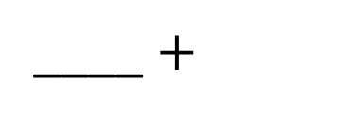
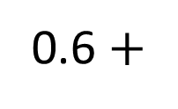
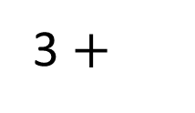
Complete the part-whole model.
3
0.6
0.5
3.627
0.02
0.007
0.02
0.007
3 $+$
0.6 $+$
____ $+$
Have a think

Slide 12
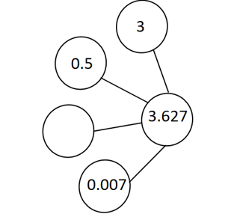
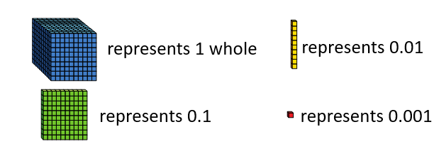
0.12
0.1

Slide 13
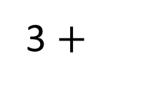
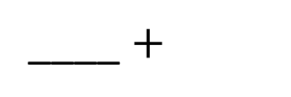
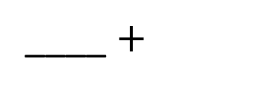
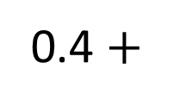
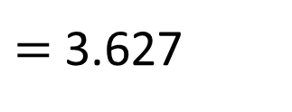
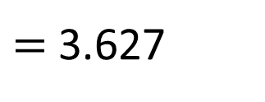
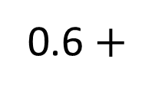
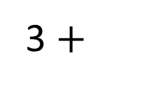
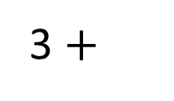
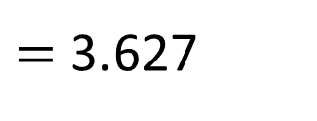
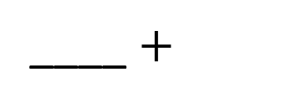
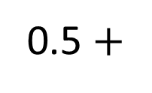
3
0.5
3 $+$
0.6 $+$
0.02
0.007
$=$ 3.627
____ $+$
3.627
0.12
3 $+$
0.5 $+$
0.12
0.007
$=$ 3.627
____ $+$
3 $+$
0.4 $+$
0.007
$=$ 3.627
____ $+$
0.007

Slide 14
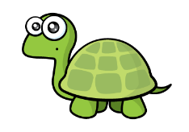
O | tth | hth
O | tth | hth
The place value chart on the left represents the largest number.
Have a think

Slide 15
O | tth | hth
O | tth | hth
2 ones, 1 tenth and 3 hundredths
1 one, 11 tenths and 3 hundredths
1.113
2.13
2.13

Slide 16
Have a go at the rest of the questions on the worksheet

