Slide 1
YEAR 1
Addition & Subtraction
Add by counting on
Number bonds to 20
Block 1 – Week 1

Slide 2
Lesson 1
Step: Add by counting on (1)

Slide 3
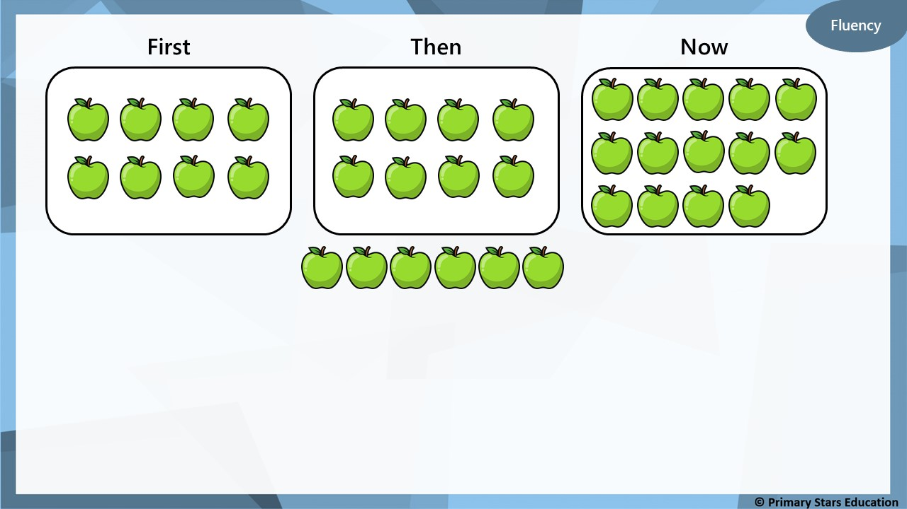
8
First there were _____ apples.
Then _____ more were added.
Now there are _____ apples.
6
14

Slide 4
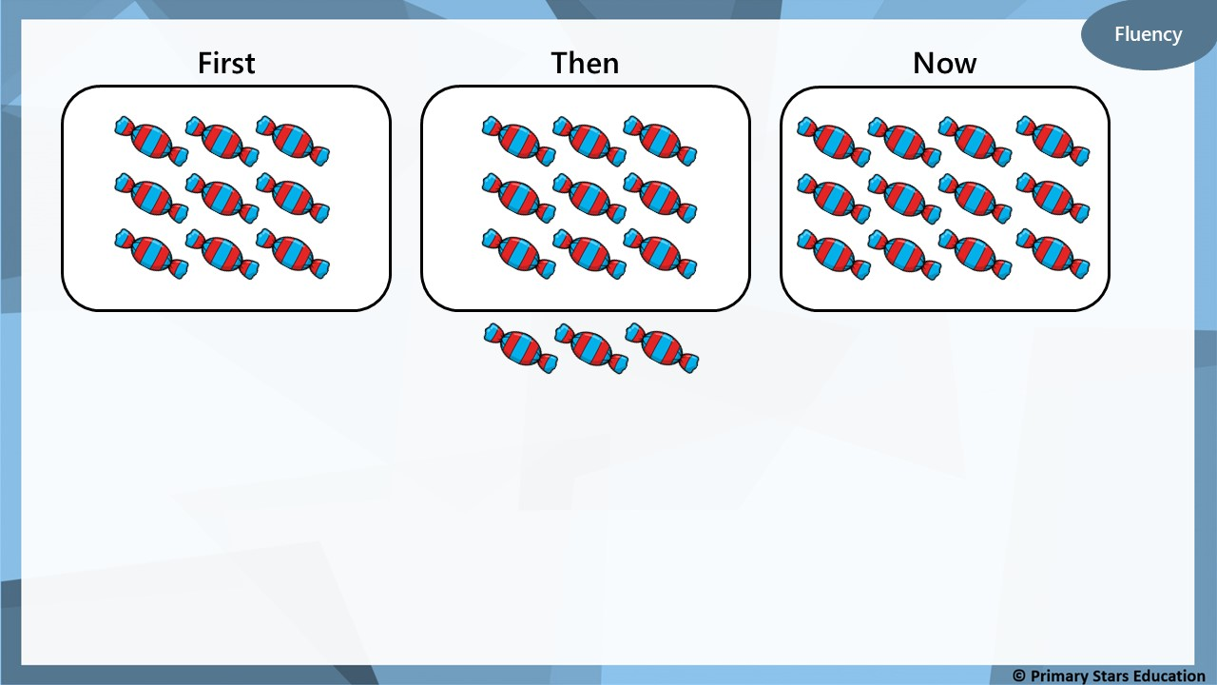
9
First there were _____ sweets.
Then _____ more were added.
Now there are _____ sweets.
3
12

Slide 5
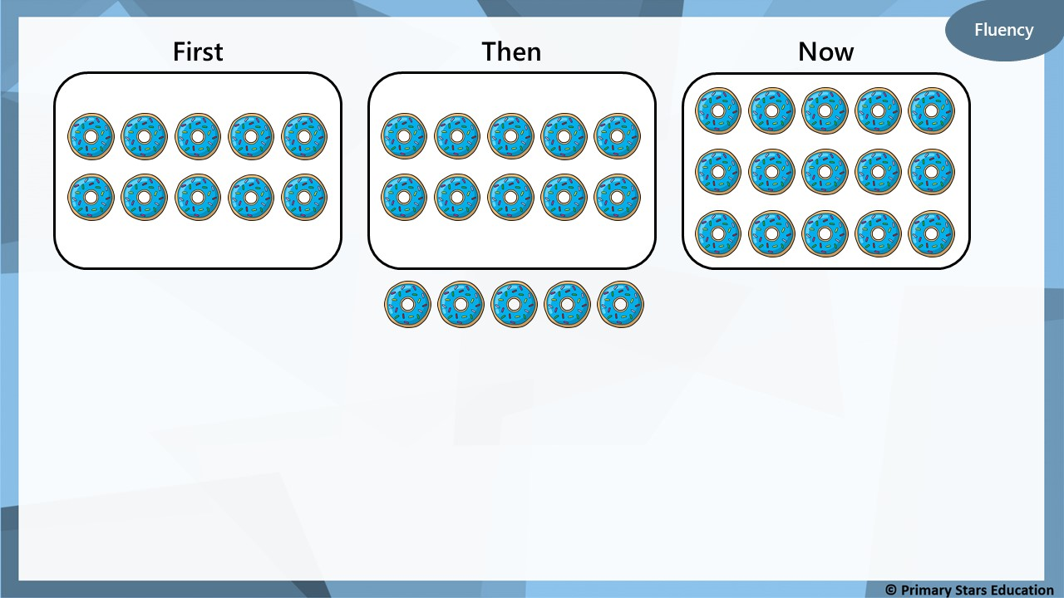
10
First there were _____ doughnuts.
Then _____ more were added.
Now there are _____ doughnuts.
5
15

Slide 6
Reasoning
I start with 9 sweets.
Then I get 8 more.
I now have more than 18 sweets.
True or false?
False.
9 + 8 = 17 (which is less than 18).

Slide 7
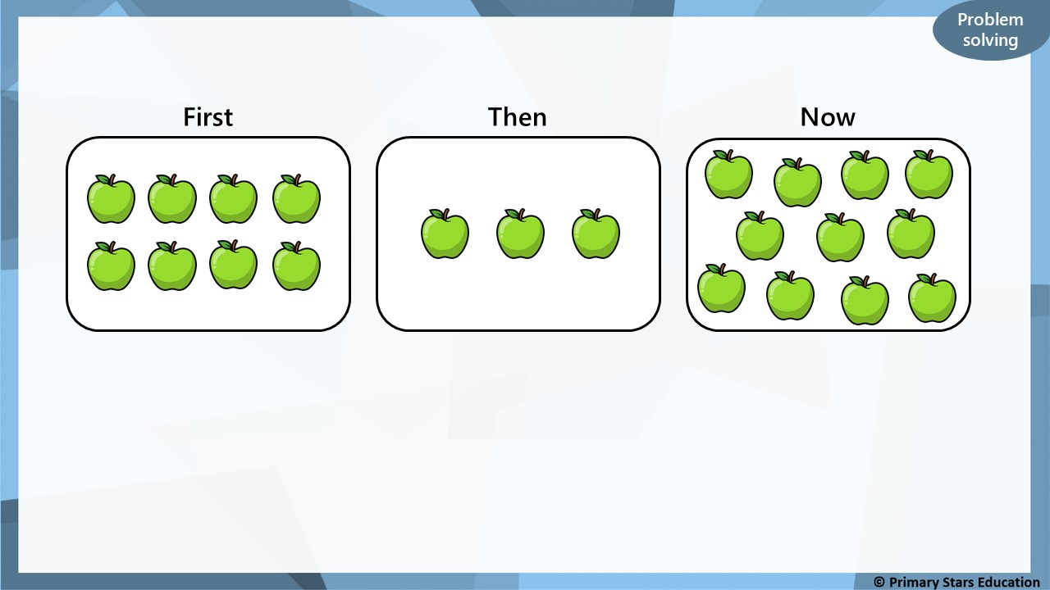
How many apples should be in the ‘Then’ box?
8
3
11
What calculation shows this: ______ + ______ = ______

