Slide 1


Year 5/6 – Autumn Block 3 – Multiplication and Division – Step 11
About This Resource:
This PowerPoint has been designed to support your teaching of this small step from the Mixed Age planning. It includes a starter activity suitable for each year group and an example of each question from the Varied Fluency and Reasoning and Problem Solving resources also provided in this pack (separate for each year group). Each slide has the year group identified in the bottom right-hand corner. We recommend that you look through this PowerPoint in advance and decide whether to work through all examples provided or a selection of them depending on the needs of your class.
National Curriculum Objectives:
Mathematics Year 5: (5C7b) Divide numbers up to 4 digits by a one-digit number using the formal written method of short division and interpret remainders appropriately for the context
Mathematics Year 6: (6C5) Identify common factors, common multiples and prime numbers
Mathematics Year 6: (6C8) Solve problems involving addition, subtraction, multiplication and division
More Year 5 and Year 6 Multiplication and Division resources.
Did you like this resource? Don’t forget to review it on our website.
© Classroom Secrets Limited 2018

Slide 2
Year 5/6 – Autumn Block 3 – Multiplication and Division
Step 11
Year 5: Divide With Remainders
Year 6: Division Using Factors
© Classroom Secrets Limited 2018

Slide 3
Introduction
Which is the odd one out?
1,526 ÷ 7
1,354 ÷ 2
1,645 ÷ 5
1,769 ÷ 6
1,212 ÷ 3
Y5
© Classroom Secrets Limited 2018

Slide 4
Introduction
Which is the odd one out?
1,526 ÷ 7 = 218
1,354 ÷ 2 = 677
1,645 ÷ 5 = 329
1,769 ÷ 6 = 294 r5
1,212 ÷ 3 = 404
1,769 ÷ 6 = 294 r5
Y5
© Classroom Secrets Limited 2018

Slide 5
Introduction
What are the factors of the following numbers?
6
60
8
80
120
Y6
© Classroom Secrets Limited 2018

Slide 6
Introduction
What are the factors of the following numbers?
6 | 1, 2, 3, 6
60 | 1, 2, 3, 4, 5, 6, 10, 12, 15, 20, 30, 60
8 | 1, 2, 4, 8
80 | 1, 2, 4, 5, 8, 10, 16, 20, 40, 80
120 | 1, 2, 3, 4, 5, 6, 8, 10, 12, 15, 20, 24, 30, 40, 60, 120
Y6
© Classroom Secrets Limited 2018

Slide 7
Varied Fluency 1
Match the questions to the correct answer.
2,471 | ÷ | 4
2,165 | ÷ | 6
2,557 | ÷ | 8
319 r5
617 r3
360 r5
Y5
© Classroom Secrets Limited 2018

Slide 8
Varied Fluency 1
Match the questions to the correct answer.
2,471 | ÷ | 4
2,165 | ÷ | 6
2,557 | ÷ | 8
319 r5
617 r3
360 r5
Y5
© Classroom Secrets Limited 2018

Slide 9
Varied Fluency 2
True or false?
The answer to the calculation below has a remainder.
3,557 | ÷ | 6
Y5
© Classroom Secrets Limited 2018

Slide 10
Varied Fluency 2
True or false?
The answer to the calculation below has a remainder.
True. The answer is 592 r5.
3,557 | ÷ | 6
Y5
© Classroom Secrets Limited 2018

Slide 11
Varied Fluency 3
The missing number is the same as the remainder.
What is the missing number?
 | 0 |  | 1 | 1 | r
6 | 1 | 2 | 6 | 8
Y5
© Classroom Secrets Limited 2018

Slide 12
Varied Fluency 3
The missing number is the same as the remainder.
What is the missing number?
The missing number is 2.
 | 0 | 2 | 1 | 1 | r | 2
6 | 1 | 2 | 6 | 8
Y5
© Classroom Secrets Limited 2018

Slide 13
Varied Fluency 4
Calculate the value of A.
1,267
A | A | A | A | 3
Y5
© Classroom Secrets Limited 2018

Slide 14
Varied Fluency 4
Calculate the value of A.
A = 316
1,267
316 | 316 | 316 | 316 | 3
Y5
© Classroom Secrets Limited 2018

Slide 15
Varied Fluency 1
Which factor pairs could you use to solve:
1,380 ÷ 60
Y6
© Classroom Secrets Limited 2018

Slide 16
Varied Fluency 1
Which factor pairs could you use to solve:
Various answers; for example:
divide by 10 then divide by 6
divide by 6 then divide by 10
divide by 12 then divide by 5
divide by 5 then divide by 12
1,380 ÷ 60
Y6
© Classroom Secrets Limited 2018

Slide 17
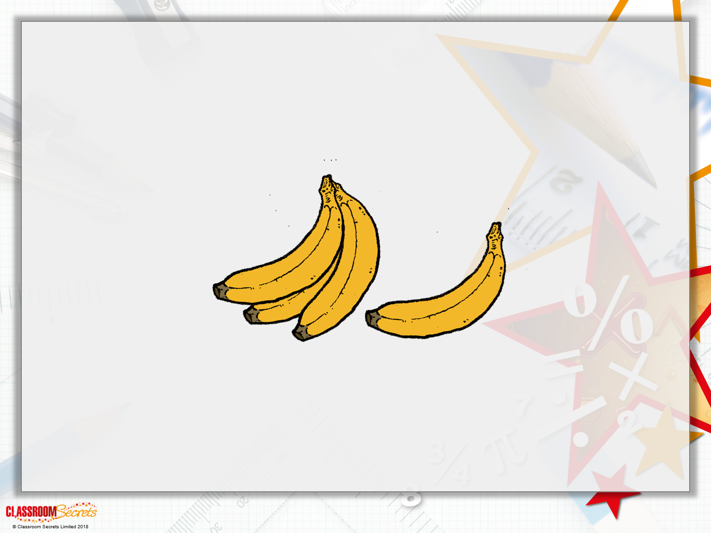
Varied Fluency 2
18 bananas are put into each packet.
The warehouse has 6,570 bananas to pack.
How many packets will they have?
Y6

Slide 18
Varied Fluency 2
18 bananas are put into each packet.
The warehouse has 6,570 bananas to pack.
How many packets will they have?
365 packets
6,570 ÷ 18
Y6

Slide 19
Varied Fluency 3
Which factor pair will solve:
9,840 ÷ 12 = 820 then 820 ÷ 12 = 68
9,840 ÷ 10 = 984 then 984 ÷ 14 = 703
9,840 ÷ 12 = 820 then 820 ÷ 2 = 410
9,840 ÷ 24
Y6
© Classroom Secrets Limited 2018

Slide 20
Varied Fluency 3
Which factor pair will solve:
9,840 ÷ 12 = 820 then 820 ÷ 12 = 68
9,840 ÷ 10 = 984 then 984 ÷ 14 = 703
9,840 ÷ 12 = 820 then 820 ÷ 2 = 410
9,840 ÷ 24
Y6
© Classroom Secrets Limited 2018

Slide 21
Varied Fluency 4
Add the missing factor to complete the statement.
7,400 ÷ 8 = 925 then 925 ÷ = 185
7,400 ÷ 40 = 185
5
Y6
© Classroom Secrets Limited 2018

Slide 22
Varied Fluency 4
Add the missing factor to complete the statement.
7,400 ÷ 8 = 925 then 925 ÷ = 185
7,400 ÷ 40 = 185
Y6
© Classroom Secrets Limited 2018

Slide 23
Reasoning 1
Ben and Josh are calculating 3,647 ÷ 4.
Who is correct? Explain your reasoning.
The answer is
911 r3.
Ben
The answer is
910 r7.
Josh
Y5
© Classroom Secrets Limited 2018

Slide 24
Reasoning 1
Ben and Josh are calculating 3,647 ÷ 4.
Who is correct? Explain your reasoning.
Ben is correct because…
The answer is
911 r3.
Ben
The answer is
910 r7.
Josh
Y5
© Classroom Secrets Limited 2018

Slide 25
Reasoning 1
Ben and Josh are calculating 3,647 ÷ 4.
Who is correct? Explain your reasoning.
Ben is correct because the remainder cannot be
greater than the divisor.
The answer is
911 r3.
Ben
The answer is
910 r7.
Josh
Y5
© Classroom Secrets Limited 2018

Slide 26
Problem Solving 1
Apples are packed into crates. One crate holds 8 apples.
There are 2,187 apples.
How many crates are needed to hold all the apples?
Y5
© Classroom Secrets Limited 2018

Slide 27
Problem Solving 1
Apples are packed into crates. One crate holds 8 apples.
There are 2,187 apples.
How many crates are needed to hold all the apples?
274 crates will be needed.
 | 0 | 2 | 7 | 3 | r | 3
 |  | 2 | 5 | 2
8 | 2 | 1 | 8 | 7
Y5
© Classroom Secrets Limited 2018

Slide 28
Problem Solving 2
Arrange the number cards below to create a calculation
which has a remainder of 1.
Complete the calculation.
6
4
7
 |  |  |  |  |  |  | r 1
6 | 2
Y5
© Classroom Secrets Limited 2018

Slide 29
Problem Solving 2
Arrange the number cards below to create a calculation
which has a remainder of 1.
Complete the calculation.
There are 2 possible answers:
2,647 ÷ 6 = 441 r1 or 2,467 ÷ 6 = 411r1
6
4
7
 |  |  |  |  |  |  | r 1
6 | 2
Y5
© Classroom Secrets Limited 2018

Slide 30

Reasoning 1
True or false?
Is he correct? Explain why.
I can use the factors 10 and 6 when dividing four thousand two hundred and eight by sixteen.
Y6

Slide 31
Reasoning 1
True or false?
Is he correct? Explain why.
He is incorrect because...
I can use the factors 10 and 6 when dividing four thousand two hundred and eight by sixteen.
Y6

Slide 32
Reasoning 1
True or false?
Is he correct? Explain why.
He is incorrect because 10 and 6 are not factors of 16. He could use 8 and 2 because they are factors of 16.
I can use the factors 10 and 6 when dividing four thousand two hundred and eight by sixteen.
Y6

Slide 33
Problem Solving 1
Find three different factor pairs that can be used to find the answer.
What is the answer to the calculation?
1,800 ÷ 36
Y6
© Classroom Secrets Limited 2018

Slide 34
Problem Solving 1
Find three different factor pairs that can be used to find the answer.
12 and 3
4 and 9
6 and 6
What is the answer to the calculation?
The answer is 50.
1,800 ÷ 36
Y6
© Classroom Secrets Limited 2018

Slide 35
Reasoning 2
Are these statements always, sometimes or never true?
Explain your answer.
Factor pairs are only even numbers.
Twenty-two has no factors.
4-digit numbers can be divided by five.
Y6
© Classroom Secrets Limited 2018

Slide 36
Reasoning 2
Are these statements always, sometimes or never true?
Explain your answer.
Sometimes true because some factor pairs are even, some are even and odd and some are odd.
Always false because 11 and 2 are factor pairs of 22.
Sometimes true if the last digit is a five or zero.
Factor pairs are only even numbers.
Twenty-two has no factors.
4-digit numbers can be divided by five.
Y6
© Classroom Secrets Limited 2018

