Slide 1
LONG DIVISION (4)

Slide 3

1) 5 thousands $=$ ______ tens
2) 2,000 ones $=$ _______ hundreds
3) 132 $÷$ 11 $=$
4) 133 $÷$ 11 $=$

Slide 4
500
1) 5 thousands $=$ ______ tens
2) 2,000 ones $=$ _______ hundreds
3) 132 $÷$ 11 $=$
4) 133 $÷$ 11 $=$
20
12
12 r1

Slide 6
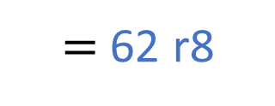
$=$ 62 r8
1,000 $÷$ 16
16
32
48
64
80
96
16 | 1 | 0 | 0 | 0
0
6
2
2,000 $÷$ 16
$$−$$
9 6
4
0
Have a think
$$−$$
3 2
8

Slide 7
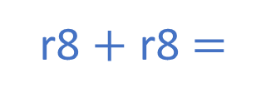
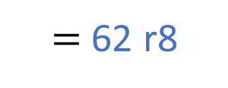
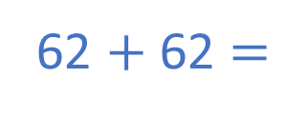
$=$ 62 r8
1,000 $÷$ 16
16
32
48
64
80
96
16 | 1 | 0 | 0 | 0
0
6
2
2,000 $÷$ 16
$$−$$
9 6
4
0
62 r8
$+$ 62 r8
$$−$$
3 2
62 $+$ 62 $=$
124
8
r8 $+$ r8 $=$
r16
124 r16
125

Slide 8
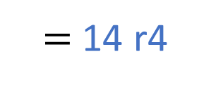
Dexter is preparing party bags.
Each party bag has 14 sweets in it.
Dexter has 200 sweets altogether.
How many party bags can he fill?
14 | 2 | 0 | 0
200 $÷$ 14
$=$ 14 r4
1
4
1 4
14
28
42
56
70
84
0
6
14 party bags
$$−$$
5 6
4
Have a think

Slide 9
How many party bags could Dexter fill if he had 800 sweets altogether?
200 $÷$ 14
$=$ 14 r4
800 $÷$ 14
14 party bags
56 party bags
57 party bags
200 $×$4 $=$ 800
14 $×$ 4 $=$ 56
r4 $×$ 4 $=$ r16
$=$ 1 r2
Have a think

Slide 10
Have a go at the questions 1 - 3 on the worksheet

Slide 11
10 $÷$ 3
Tens | Ones
3 | 1 | 0
0
3
r1
1

Slide 12
10 $÷$
$=$ 3 r1
Tens | Ones
3 | 1 | 0
0
3
r1
$=$3
9 $÷$ $=$ 3
1
9 $÷$ 3 $=$

Slide 13
r2
57 $÷$ $=$ 11
Have a think
Tens | Ones
55 $÷$ $=$ 11
$=$ 5
55 $÷$ 11 $=$

Slide 14
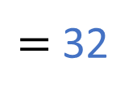
1,571 $÷$ $=$ 49
r3
1,568 $÷$ $=$ 49
49 | 1 | 5 | 6 | 8
0
3
2
1,568 $÷$ 49 $=$
50
100
150
200
250
300
$$−$$
1 4 7
$−$1
$−$2
$−$3
$−$4
$−$5
$−$6
9
8
49
98
147
196
245
294
$$−$$
9 8
0
$=$ 32
Have a think

Slide 15
Have a go at the questions on the worksheet

