Slide 1
Year 5/6 – Autumn Block 2 – Multiplication and Division – Step 8
About This Resource:
This PowerPoint has been designed to support your teaching of this small step from the Mixed Age planning. It includes a starter activity suitable for each year group and an example of each question from the Varied Fluency and Reasoning and Problem Solving resources also provided in this pack (separate for each year group). Each slide has the year group identified in the bottom right-hand corner. We recommend that you look through this PowerPoint in advance and decide whether to work through all examples provided or a selection of them depending on the needs of your class.
National Curriculum Objectives:
Mathematics Year 5: (5C6a) Multiply and divide numbers mentally drawing upon known facts
Mathematics Year 5: (5C7a) Multiply numbers up to 4 digits by a one- or two-digit number using a formal written method, including long multiplication for two-digit numbers
More Year 5 and Year 6 Multiplication and Division resources.
Did you like this resource? Don’t forget to review it on our website.
© Classroom Secrets Limited 2018

Slide 2
Year 5/6 – Autumn Block 2 – Multiplication and Division
Step 8
Year 5: Multiply 3-Digits by 2-Digits
© Classroom Secrets Limited 2018

Slide 3
Introduction
Write a story for the following multiplication:
142 x 12
Then solve the calculation.
Y5
© Classroom Secrets Limited 2018

Slide 4
Introduction
Write a story for the following multiplication:
142 x 12 = 1,704
For example:
Bill the baker has received an order for 142 dozen muffins. There are 12 muffins in a dozen. How many muffins does he have to bake?
Tanya is organising the art cupboard. 142 paint brushes will fit in a box. She fills 12 boxes. How many paint brushes does she have?
Y5
© Classroom Secrets Limited 2018

Slide 5
Varied Fluency 1
Use the grid method to complete the calculation below.
x | 40 | 2
100
10
2
112 | x | 42 | =
Y5
© Classroom Secrets Limited 2018

Slide 6
Varied Fluency 1
Use the grid method to complete the calculation below.
x | 40 | 2
100 | 4,000 | 200
10 | 400 | 20
2 | 80 | 4
112 | x | 42 | = | 4,704
Y5
© Classroom Secrets Limited 2018

Slide 7
Varied Fluency 2
Fill in the missing numbers in the calculation below.
 | 2 | 2 | 1
x |  | 1
 |  | 6 | 3
2 | 2 | 1 | 0
 | 8 |  | 3
Y5
© Classroom Secrets Limited 2018

Slide 8
Varied Fluency 2
Fill in the missing numbers in the calculation below.
 | 2 | 2 | 1
x |  | 1 | 3
 | 6 | 6 | 3 | (221 x 3)
2 | 2 | 1 | 0 | (221 x 10)
2 | 8 | 7 | 3
Y5
© Classroom Secrets Limited 2018

Slide 9
Varied Fluency 3
Complete the calculations below.
Which has the larger answer?
 | 1 | 0 | 1
x |  | 4 | 2
 | 3 | 1 | 6
x |  | 1 | 2
Y5
© Classroom Secrets Limited 2018

Slide 10
Varied Fluency 3
Complete the calculations below.
Which has the larger answer?
101 x 42 has the larger answer.
 | 1 | 0 | 1
x |  | 4 | 2
 | 2 | 0 | 2
4 | 0 | 4 | 0
4 | 2 | 4 | 2
 | 3 | 1 | 6
x |  | 1 | 2
 | 6 | 3 | 2
 |  | 1
3 | 1 | 6 | 0
3 | 7 | 9 | 2
Y5
© Classroom Secrets Limited 2018

Slide 11
Varied Fluency 4
Use <, > or = to complete the statements.
221 x 13 |  | 313 x 13
102 x 42 |  | 302 x 22
Y5
© Classroom Secrets Limited 2018

Slide 12
Varied Fluency 4
Use <, > or = to complete the statements.
2,873 | < | 4,069
4,284 | < | 6,644
Y5
© Classroom Secrets Limited 2018

Slide 13
Reasoning 1
A zookeeper wants to work out the area of the zoo. He does the calculation 132 + 32. Explain his mistake.
What is the correct area of the zoo?
123m
Area = 164m²
32m
Y5
© Classroom Secrets Limited 2018

Slide 14
Reasoning 1
A zookeeper wants to work out the area of the zoo. He does the calculation 132 + 32. Explain his mistake.
The zookeeper has used the wrong numbers…
What is the correct area of the zoo?
123m x 32m =
123m
Area = 164m²
32m
Y5
© Classroom Secrets Limited 2018

Slide 15
Reasoning 1
A zookeeper wants to work out the area of the zoo. He does the calculation 132 + 32. Explain his mistake.
The zookeeper has used the wrong numbers and he has added them instead of multiplying them together.
What is the correct area of the zoo?
123m x 32m = 3,936m²
123m
Area = 164m²
32m
Y5
© Classroom Secrets Limited 2018

Slide 16
Problem Solving 1
A restaurant owner wants to work out which item on the menu was most profitable last week.
How much money did she make from each item on the menu?
Item | Number of sales | Price per item (£)
Pizza | 412 | 12
Soup | 179 | 10
Pasta | 613 | 13
Y5
© Classroom Secrets Limited 2018

Slide 17
Problem Solving 1
A restaurant owner wants to work out which item on the menu was most profitable last week.
How much money did she make from each item on the menu?
Pizza: 412 x £12 = £4,944
Soup: 179 x £10 = £1,790
Pasta: 613 x 13 = £7,969
Item | Number of sales | Price per item (£)
Pizza | 412 | 12
Soup | 179 | 10
Pasta | 613 | 13
Y5
© Classroom Secrets Limited 2018

Slide 18
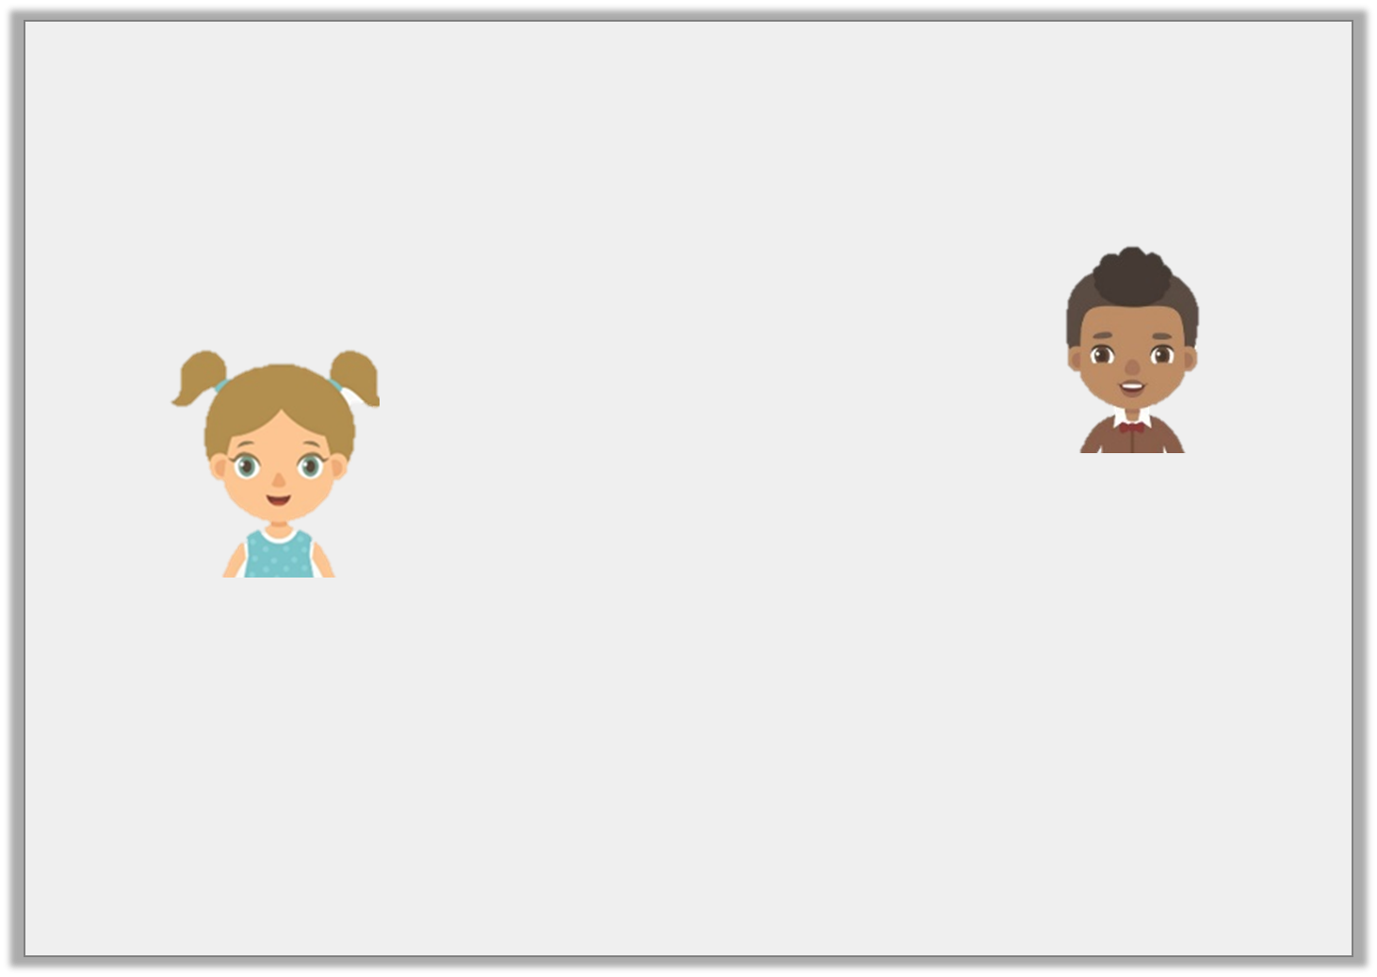
Reasoning 2
Rosie and Yusef are discussing multiplication.
Who is correct? How do you know?
I think that 14 x 121 is bigger than 142 x 12.
I think that 142 x 12 is bigger than 14 x 121.
Yusef
Rosie
Y5
© Classroom Secrets Limited 2018

Slide 19
Reasoning 2
Rosie and Yusef are discussing multiplication.
Who is correct? How do you know?
Rosie is correct because…
I think that 14 x 121 is bigger than 142 x 12.
I think that 142 x 12 is bigger than 14 x 121.
Yusef
Rosie
Y5
© Classroom Secrets Limited 2018

Slide 20
Reasoning 2
Rosie and Yusef are discussing multiplication.
Who is correct? How do you know?
Rosie is correct because 14 x 121 = 1,694 and 142 x 12 = 1,704.
I think that 14 x 121 is bigger than 142 x 12.
I think that 142 x 12 is bigger than 14 x 121.
Yusef
Rosie
Y5
© Classroom Secrets Limited 2018

