Slide 1
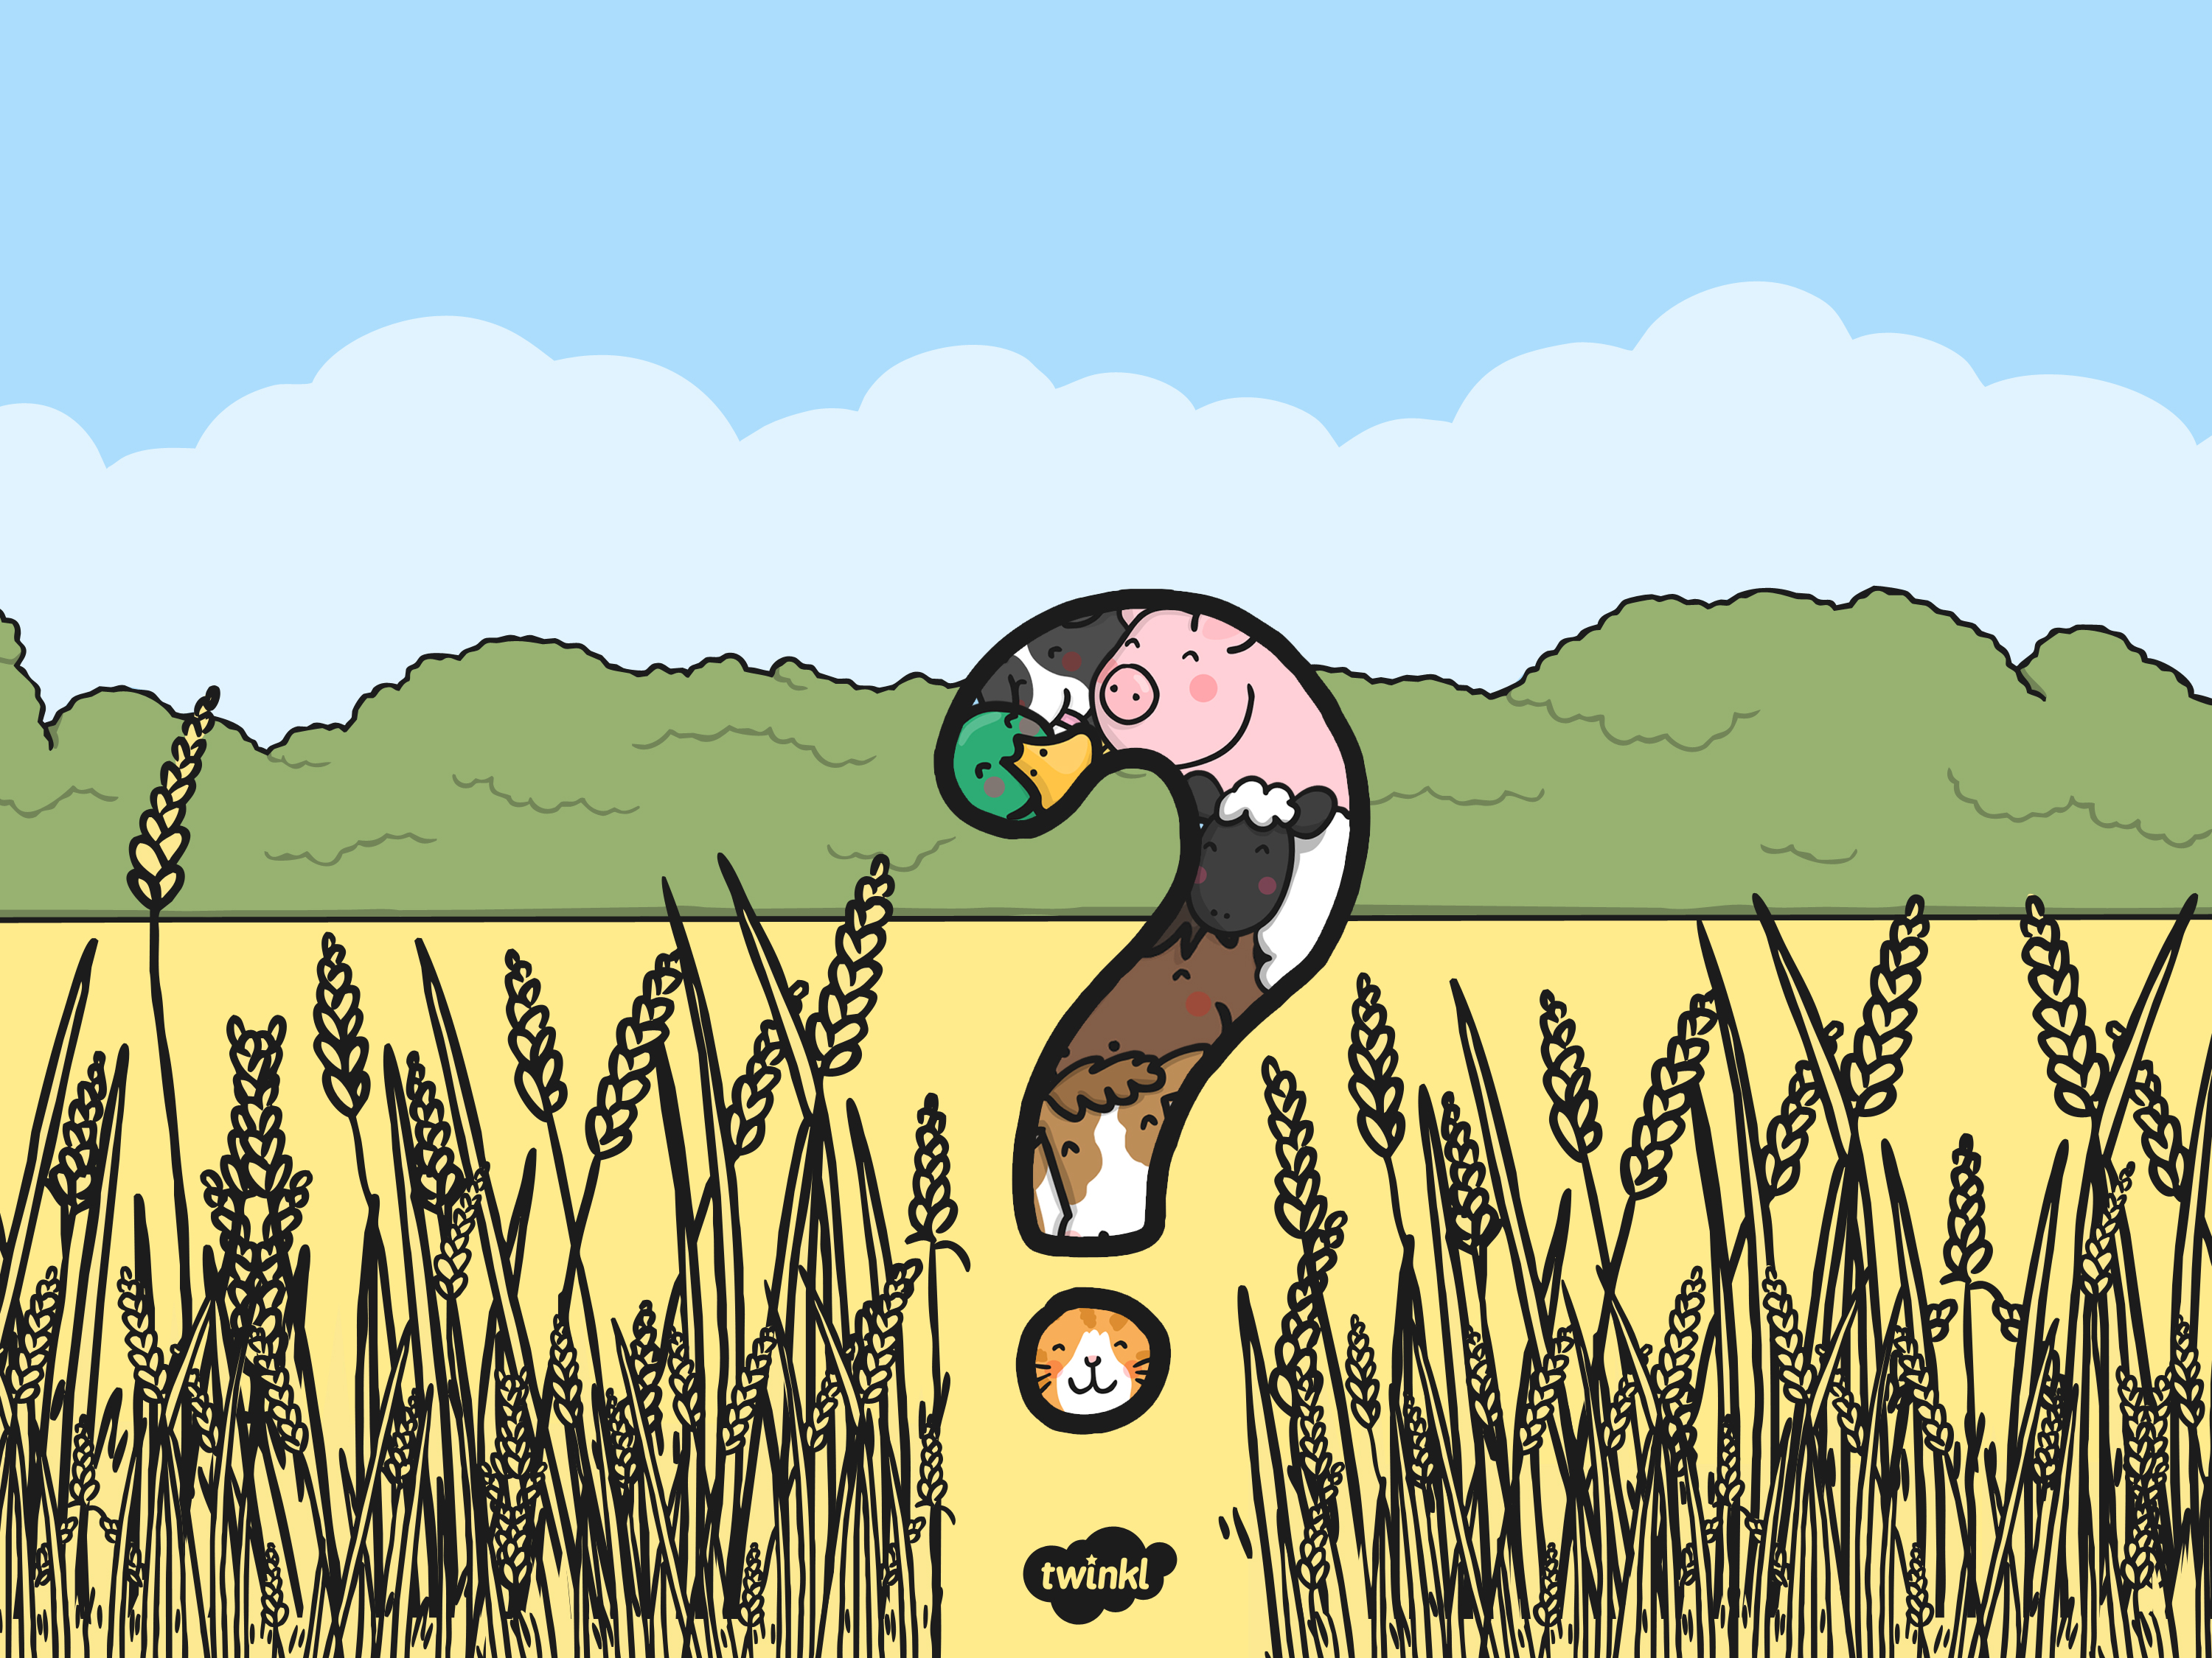
What Am I?
A farm animal description game

Slide 2
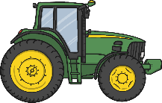
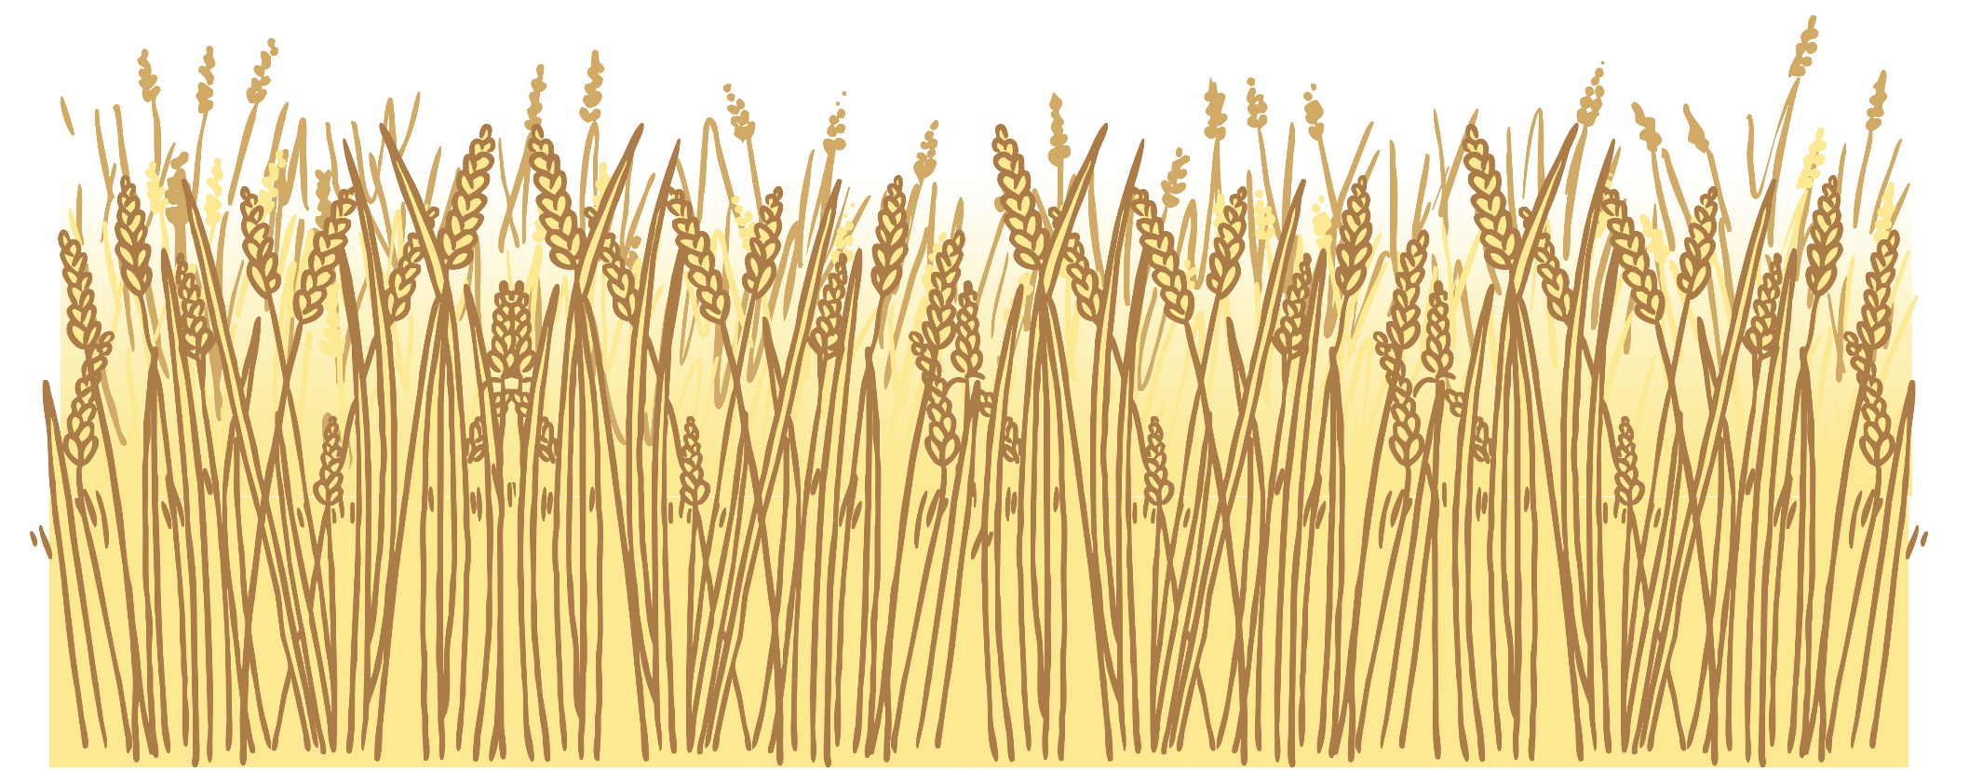
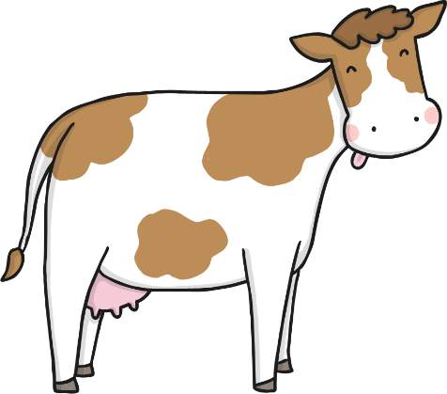
Click on the tractors for clues
I have 4 stomachs.
I live in a field.
I like to chew grass.
What am I?
I am a cow!

Slide 3
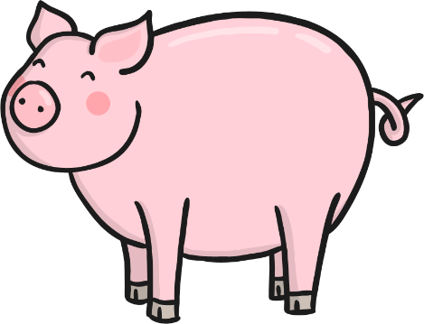
Click on the tractors for clues
Despite rumours, I am actually very clean.
I like to roll around in mud.
I live in a sty.
What am I?
I am a pig!

Slide 4
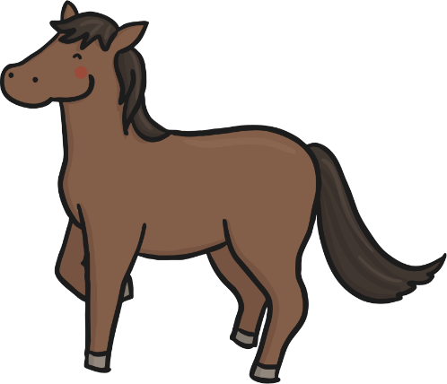
Click on the tractors for clues
I am very fast.
I eat hay.
I live in a stable.
What am I?
I am a horse!

Slide 5

Click on the tractors for clues
I live near water.
I waddle when I walk.
Humans like to feed me bread in parks!
What am I?
I am a duck!

Slide 6
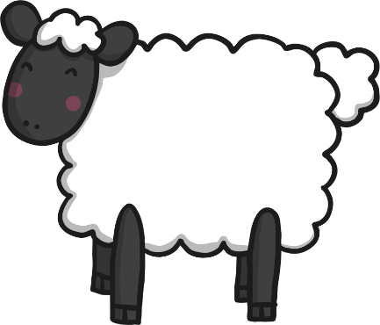
Click on the tractors for clues
I live in a flock.
I eat grass.
My coat is very fluffy and warm.
What am I?
I am a sheep!

Slide 7
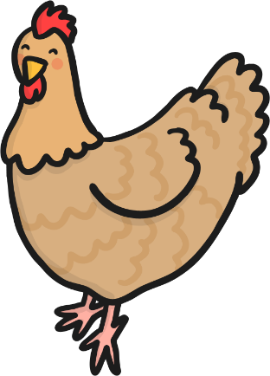
Click on the tractors for clues
I am an important source of protein for humans.
I have wings.
I make clucking noises.
What am I?
I am a chicken!

Slide 8
