Slide 1
Monday 4th May - Agility @ 2pm
With Mr Jones
You will need:
-Up to 10 Cones or soft toys
-1 ball
-Long piece of string or rope.
-A small space
-A partner if possible (but not essential).

Slide 2
Pupils will be able to :
Demonstrate how to change direction quickly.(Physical)
To be ambitious.(Mental)
To improve your knowledge of what is happening within your body. (Mental)
To understand what the word agility mean. (Mental)

Slide 3
What is Agility?
Agility is being able to change direction quickly. It is a fundamental movement for children of all ages.

Slide 4
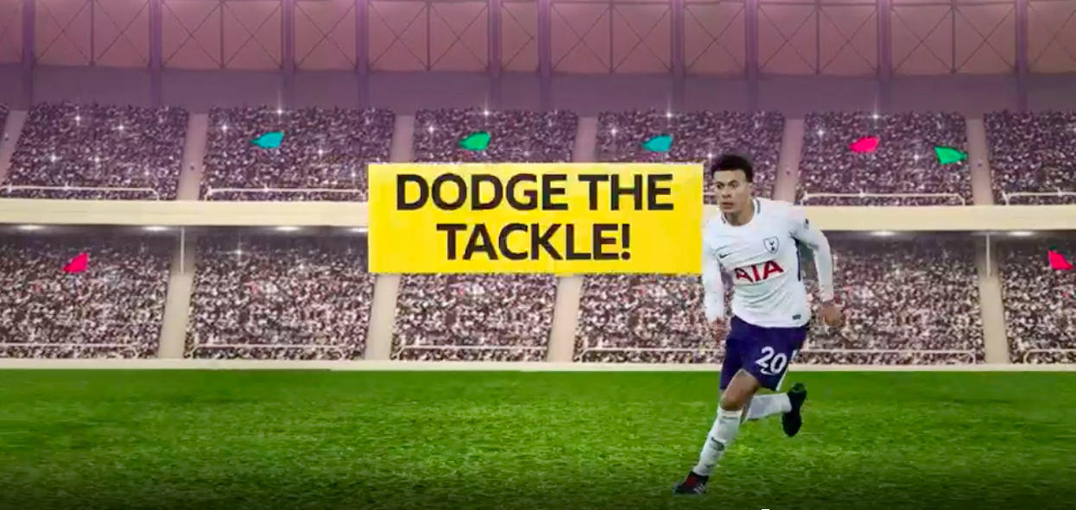
Warm Up
https://www.bbc.co.uk/teach/supermovers/just-for-fun-match-of-the-Day-l2/zbnw382

Slide 5
1st Half -Agility
1- Move quickly and in control to your left pick the item up and move it quickly and in control over the line on the right.
2-Change sides and repeat.

Slide 6
1st Half -Agility
Make it easier | Make it harder
Use fewer objects Narrow the space between the objects Use larger equipment | Collect and move more objects Widen the space between objects Collect smaller equipment

Slide 7
1st Half -Agility
1- Move quickly and in control to the item that is shouted out.
2- Perform different movements in between the commands e.g Star Jumps.
3-To avoid accidents, have an item each to pick up and first to collect wins.

Slide 8
1st Half -Agility
Make it easier | Make it harder
Narrow the space between the objects Take away the object and pick a point to touch | Widen the space between objects Add more objects Perform more commands Have your back turned.

Slide 9
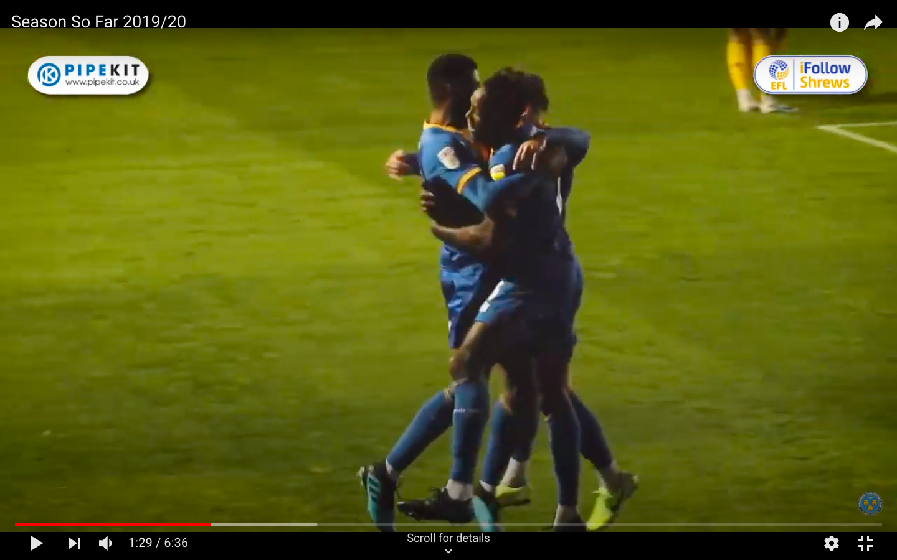
Half Time-Players in action
https://www.youtube.com/watch?v=87ckjwIIl8g&t=320s

Slide 10
2nd Half -Obstacles
1- Move quickly and in control around the objects that are in your way.
2- Travel back through the area.
3- Time your self.
Key Points
-Keep your feet shoulder width apart.
-Stay on the balls of your feet.
-Push off the outside foot.
-Turn your hips to the new direction
-Drive towards the new direction

Slide 11
2nd Half -Obstacles
1- Move quickly and in control around the objects that are in your way.
2- Travel back through the area.
3- Time your self.
Key Points
-Keep your feet shoulder width apart.
-Stay on the balls of your feet.
-Push off the outside foot.
-Turn your hips to the new direction
-Drive towards the new direction

Slide 12
Full Time Questions?
1-How can you prepare yourself to change direction quickly and in control to move away from the items?
2 -Which muscles are you using when you change direction?
3-What other skills are you using?
4- Which sports would you use this movement in?

Slide 13
Pupils will be able to :
Demonstrate how to change direction quickly.(Physical)
To be ambitious.(Mental)
To improve your knowledge of what is happening within your body. (Mental)
To understand what the word agility mean. (Mental)

