Slide 1
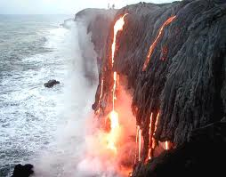
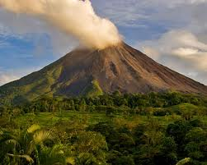
Structure of a volcano Objective To learn about volcanoes
MUST be able to understand how volcanoes form and why
SHOULD be able to explain active, dormant and extinct volcanoes
COULD think examples of famous volcanoes and earthquakes

Slide 2
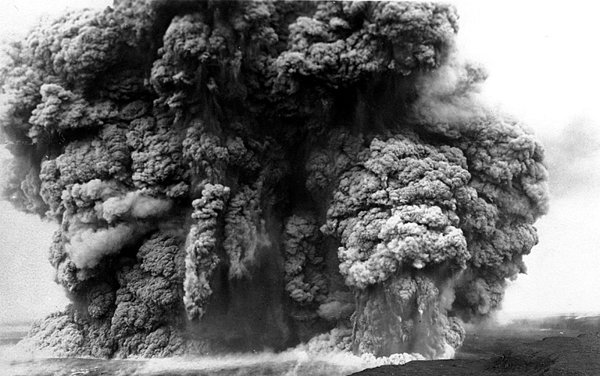
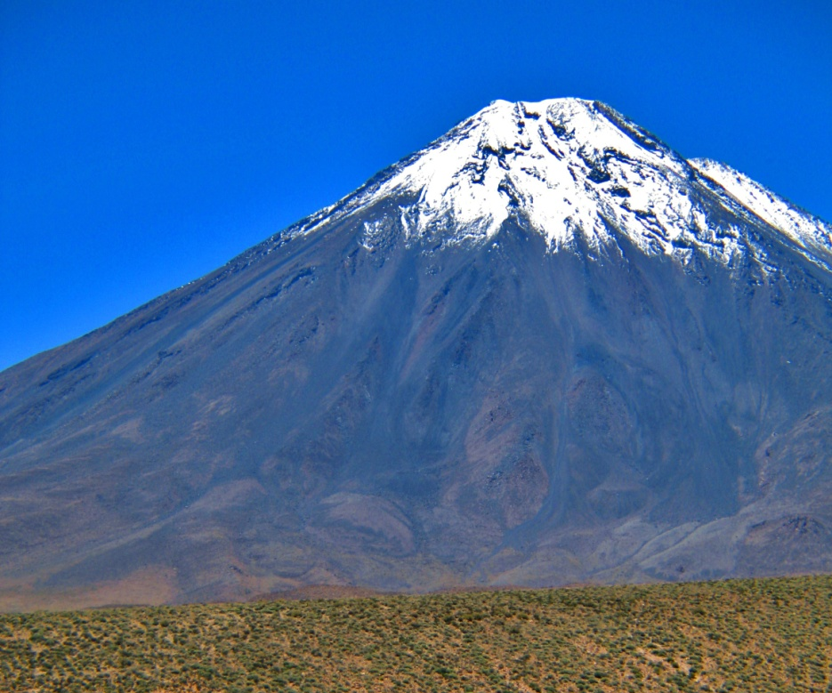
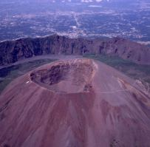
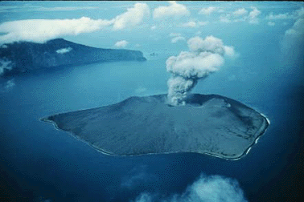
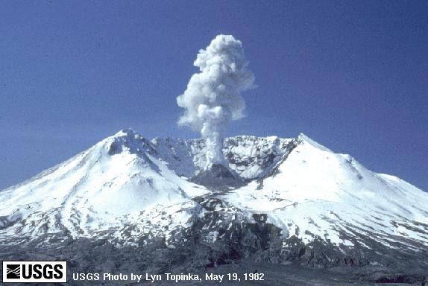
Notes:
Starter continued: brief look at the different shapes that volcanoes can have. 1 minute.

Slide 3
Some new key words volcanoes
Volcano
Vent
Secondary cone
Lava
Dormant
Eruption
Volcanic dust
Volcanic ash
Magma chamber
Volcanic gas
Cone
Crater
Active
Extinct
Notes:
Note down the key words for today’s lesson onto the key word page from the start of the unit. 3 minutes.

Slide 4
What is a volcano?
A volcano is an opening in the Earths crust known as a vent. Magma from inside the earth is forced out and erupts as lava, ash, gas, and dust. When these materials are forced through the vent is causes an eruption.
Notes:
What is a volcano? A brief explanation for the class to gain some understanding of a volcano. 1 minute.

Slide 5
How do volcanoes form?

Slide 6
Volcano erupts

Slide 7
Volcano builds up

Slide 8
Volcano formed

Slide 9
Gas, ash, dust
crater
Secondary cone
Lava
Layers of ash and lava
cone
Main vent
Magma chamber
Notes:
The structure of a volcano. Go over the diagram with the class explaining each label as it appears. Class need to listen carefully to the information. 5 minutes.

Slide 10
Gas, ash, dust
Activities:
Complete activity 2 on p119 - clearly and well labelled.
For each of the following terms write a definition into your book using page 118 and the glossary: volcano, vent, crater, magma chamber.
Explain the difference between lava and magma.
crater
Secondary cone
Lava
Layers of ash and lava
Main vent
Magma chamber
Extension: read p 118 and 119 then answer question 4 into your book
15 minutes
Notes:
Main activities: students need to label the diagram with the key words they have learnt. Some of the main key words need to have the definitions written down so that the student can learn some of them in more detail. 10 minutes. Extension: thinking exercise from page 119.

Slide 11
Volcanoes can be either Active, Dormant or Extinct.
Active Volcanoes
A volcano which has erupted recently
Dormant Volcanoes
A volcano which has erupted in the last 2000 years,
but not recently is dormant or asleep.
Extinct Volcanoes
A volcano which is unlikely to erupt ever again and is dead or extinct.

Slide 12
Key words.
You and the person sat next to you have just 5 minutes to quietly discuss the key words you wrote down at the start of lesson ready to explain them to the rest of the class.
Notes:
Activity to gain better understanding of the key terms. May be missed and saved for next lesson of time is running short.

Slide 13
Test!
Time now for a little test. Ten definitions are going to be shown and you have TEN seconds to write down the answer of each.
1
10
9
8
7
6
5
4
3
2
1
Fumes from the volcano

Slide 14
2
10
9
8
7
6
5
4
3
2
1
The pipe up which the magma comes

Slide 15
3
10
9
8
7
6
5
4
3
2
1
Molten rock erupting from a volcano

Slide 16
4
10
9
8
7
6
5
4
3
2
1
The top of the volcano

Slide 17
5
10
9
8
7
6
5
4
3
2
1
The shape of the volcano

Slide 18
6
10
9
8
7
6
5
4
3
2
1
Solids from the volcano

Slide 19
7
10
9
8
7
6
5
4
3
2
1
Molten rock before it is erupted

Slide 20
8
10
9
8
7
6
5
4
3
2
1
The area beneath the volcano

Slide 21
9
10
9
8
7
6
5
4
3
2
1
A period of volcanic activity

Slide 22
10
10
9
8
7
6
5
4
3
2
1
A place where lava erupts at the Earth’s surface

Slide 23
Answers
Volcanic gas
Main vent
Lava
Crater
Cone
Ash
Magma
Magma chamber
Eruption
Volcano

Slide 24
How do we know that the continents have moved over time?

Slide 25
Why are plate boundaries known as danger zones?

Slide 26
If constructive boundaries create more crust why isn’t the Earth getting bigger?

Slide 27
When all the continents were joined together it was called Pangaea: what happened to it?
How? Why?

